Slide 1
SEC530
Defensible Security Architecture
SEC530: Defensible Security Architecture
Eric Conrad (GSE # 13) and Justin Henderson (GSE # 108)
@eric_conrad and @SecurityMapper

Slide 2


About Us
Justin Henderson | @SecurityMapper
SEC555/SEC530/SEC455 Author & Instructor
GIAC GSE # 108, Cyber Guardian Blue and Red
60 industry certifications
Eric Conrad | @eric_conrad
MGT414/SEC511/SEC530/SEC542 Author & Instructor
GIAC GSE # 13, Cyber Guardian Red
SANS Faculty Fellow

Slide 3
Where We Came From
Perimeter defense is "a sort of crunchy shell around a soft, chewy center."¹
Bill Cheswick (1990), describing the first internet gateways (proxy firewalls)
This was a reasonable design in 1990
We have come a long way since then, but many organizations still have this "candy bar" design
Hard on the outside, soft on the inside
Flat networks with little to no internal segmentation
A hardened perimeter, but many weaker/unpatched internal systems

Slide 4
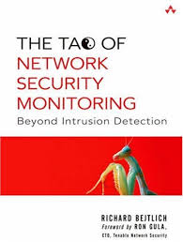
Defensible Security Architecture
The term "Defensible Networks" was coined by Richard Bejtlich in The Tao of Network Security Monitoring
I use the term defensible networks to describe enterprises that encourage, rather than frustrate, digital self-defense.¹
Bejtlich makes these points about defensible networks:
Defensible networks can be watched
Defensible networks limit an intruder’s freedom to maneuver
Defensible networks offer a minimum number of services
Defensible networks can be kept current¹

Slide 5
Defensible Network Architecture 2.0
Richard Bejtlich later refined the idea of Defensible Networks, using the term Defensible Network Architecture 2.0, which he described as having the following characteristics:
Monitored
Deploy IDSes and IPSes
Inventoried
Know every host and application
Controlled
Ingress and egress filtering
Claimed
Identify owners of all systems
Minimized
Reduce the attack surface
Assessed
Conduct vulnerability assessments
Current
Patched¹

Slide 6
Case Study: NotPetya
NotPetya is part of a family of malware based on the leaked (alleged) NSA hacking tools, including ETERNALBLUE
This exploit targeted Windows Server Message Block (SMB, TCP port 445) and was patched by MS17-010¹
This malware would typically enter an environment via SMB
It would then use Mimikatz to attempt to steal credentials and move laterally through a network via Microsoft PSExec and WMIC (Windows Management Instrumentation Console
Automated malware is now behaving like human penetration testers
If an organization had one unpatched system and 999 patched: all 1,000 could become compromised
This is dependent on internet network segmentation, trust models, etc.

Slide 7
SEC530 Problem Solving
If perimeter security is not the answer then…
We need to buy next-gen security products FALSE
We need to use existing things in new ways TRUE
Example wins with solutions you likely own:
Private VLANs
NetFlow
Darknet Routing
HSTS Preloading
Creates defense-in-depth and complimentary capabilities
Explicit Proxies
Sender Authentication and checks
File Classification w/controls
WAF central policies

Slide 8
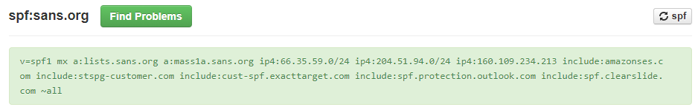
Sender Policy Framework (SPF)
DNS record validates email sent from an authorized source
Based on authorized IP addresses
Based on DNS domain information (A record, MX record)
Can specify no email comes from a specific sub-domain

Slide 9
dnstwist¹
Proxy can protect against cousin domains (sec53O.com)
Possible to add all possible domains into proxy
Should configure to block or quarantine and alert
Requires identifying all possible domain permutations
dnstwist calculates permutations against a given domain
Also checks to see if any domains have been registered
And provides additional information about the domain
Use dnstwist with scripting to handle deal with evil cousins

Slide 10
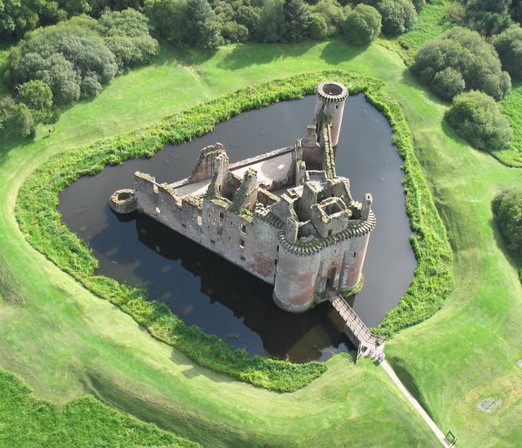
Know Thy Organization
A defensible architecture requires organizational awareness
What are critical assets?
Where are the critical assets?
Why are they considered critical assets?
What do these assets need to function?
Knowing the above questions allows defenses to be built
Network-centric defenses build a security moat
Data-centric defenses secure the treasure in the castle

Slide 11

Suricata
Suricata is a modern open-source IDS/NSM
Developed by Open Information Security Foundation
Supports snort rules and application identification
Generates alerts and network metadata logs
Example signature rule:
alert tcp any any -> any !22 (msg:"SURICATA SSH non-standard port"; flow:to_server; app-layer-protocol:ssh; sid:5300001; rev:1;)

Slide 12
Bro
Suricata is both an IDS and NSM in that it creates logs
Bro is built for creating logs from network traffic
Requires sensor placement and network visibility
Network Protocols |  |  |  |  | Files | Detection
conn.log | http.log | radius.log | smb_mapping.log | syslog.log | files.log | intel.log
dce_rpc.log | irc.log | rdp.log | smtp.log | tunnel.log | pe.log | notice.log
dhcp.log | kerberos.log | rfb.log | snmp.log |  | x509.log | signatures.log
dnp3 | modbus.log | sip.log | socks.log |  |  | traceroute.log
dns.log | mysql.log | smb_cmd.log | ssh.log
ftp.log | ntlm.log | smb_files.log | ssl.log

Slide 13
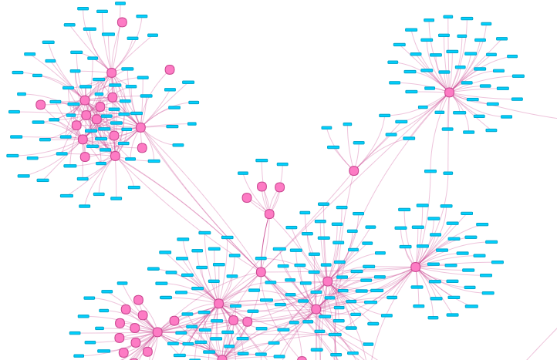
Power of Network Metadata
IDS signatures look for known bad
Network metadata is simply data
Allows for learning the environment and identifying:
Abnormal events
Unusual/newly observed/random domains or user-agents
Unauthorized assets
Computer DHCP but not in Active Directory or asset system
Vulnerable or misconfigured assets
Old operating systems or applications on the network

Slide 14



SSL Inspection
Security devices like NGFW or web proxies support SSL Inspection
Functions similar to a proxy service
Security device acts as trusted CA to internal devices
Issues certificates per site accessed
Fixes visibility issues such as perfect forward secrecy blindness
Requires systems to trust security device as CA
decrypt, analyze, re-encrypt
Encrypted session # 1
Encrypted session # 2

Slide 15

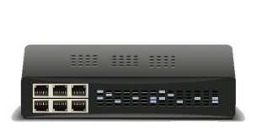
SSL Decrypt Mirror Port
Modern devices with SSL Inspection also support SSL decrypt mirroring
Decrypted packets are mirrored out an interface
Puts NSM/IDS back in the game
Decrypted traffic shows up with the original port such as 443
But reflects decrypted data
IDS should include 443 in $HTTP_PORTS
LAN
WAN
HTTPS
HTTPS
Mirror Port
Decrypted HTTPS

Slide 16
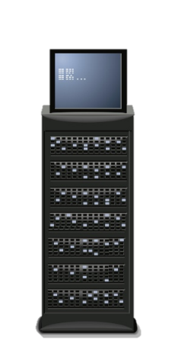


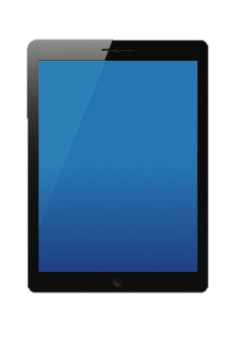
Finding Sensitive Data
Need to identify key data and where it is expected
File servers
Database servers
USB drives
Next, is to realize where it may end up
Laptops
Mobile phones
Personal USB devices
Expected
Probable
reality

Slide 17
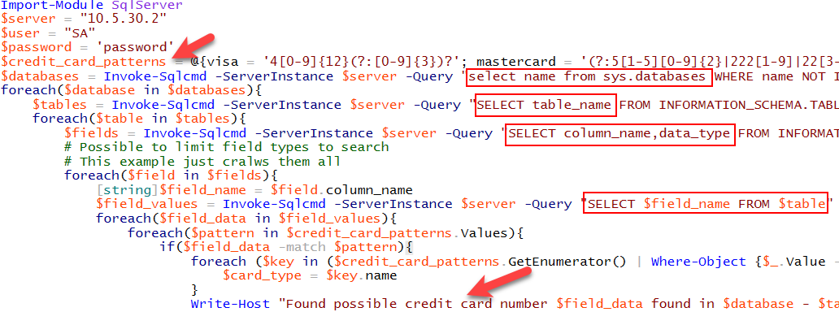
Content Discovery Script Example
Less than 40 lines of code including 10 lines of comments
Loops through each database, table, and column and checks all values

Slide 18
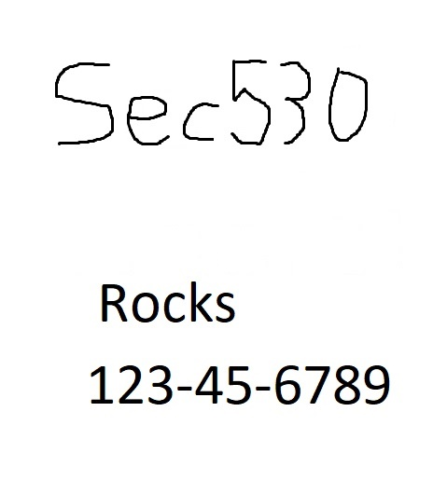
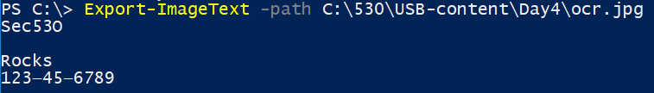
Optical Character Recognition (OCR) Integration
File classification supports OCR of TIFF (faxes and scans)
Vendor solutions have more file support and OCR capabilities
Possible to live off the land with PowerShell
Find certain files such as JPG
OCR scan them looking for sensitive data
If sensitive content found add file property
Can be integrated into automatic classification

Slide 19
Zero Trust Architecture
Developed by Forrester's John Kindervag in 2010¹
Data-centric focus
Basic principles of zero trust:
Network is always hostile
Internal and external threats are always present
Internal network is not sufficient to equal trusted
Every device, user, and network flow must be proven
Log and inspect all traffic

Slide 20
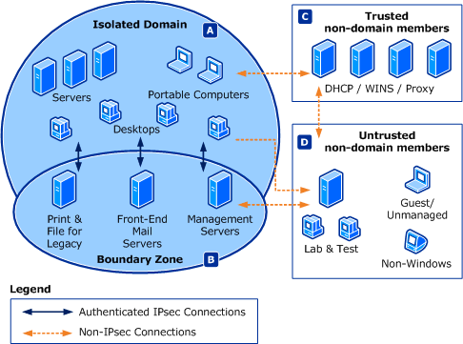
Windows Domain Isolation
Windows natively supports IPSec for domain isolation
Blocks unauthorized non-domain access
Authenticates all traffic
Mutually authenticated
Optionally encrypts traffic
Cannot attack the invisible
Mitigates man-in-the-middle
Lowers service exploitation risk

Slide 21

Variable Trust
Access controlled by variable trust
Similar to real-life credit scores
User authentication with username/password 10 points
Device authentication 10 points
Known device and location 10 points
Access to PCI database requires 40 points
Multifactor authentication with smart card 20 points
Access to PCI database GRANTED

